Slide 1




Operation Castle
Neighbourhood
Watch Presentation
Notes:
<Operation Background >

Slide 2
Introductions
DI Kevin O’Rourke
DS Steve Byrom
DS Alan Williams
Operation Castle – The team deal with residential burglaries, force wide and cross border into Cheshire, North Wales, Lancashire and GMP.
12 x investigators
Since its launch in 2017 we have convicted numerous offenders to a total of 881 years in HMP custody.
Notes:
<Operation Background>

Slide 3


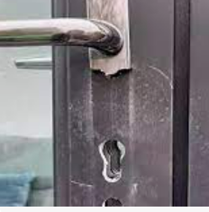

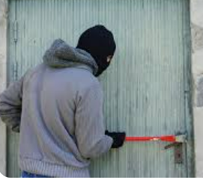
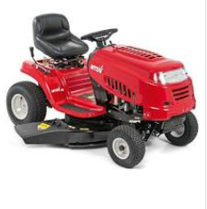
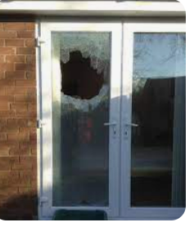
Common MO
Insecure windows & doors
Smashed window to gain entry
Forced door/window open with tools
Snap lock in patio/rear door
Use your own ladders which are not secure
Use your own garden tools which are not secure – rakes, spades and hoe
Burning the door lock out with a blow torch
Hook and cane for vehicle keys
Removal of CCTV/VRE and alarm boxes
Whilst cutting the lawn
Distraction burglary – targeting the vulnerable
Notes:
<Operation Background>

Slide 4

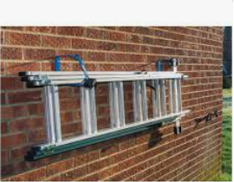


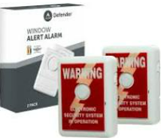

Prevention
Secure windows and doors – consider sensors
Secure garden tools in a secure shed/garage
Secure ladders with a chain lock and keep them out of sight
If you have an alarm, use it !
Use the locking mechanism in UPVC doors
Close the curtains
Keep high value possessions out of sight – car keys, jewellery etc
Invest in CCTV/VRE/Ring doorbell
Security lighting
Secure doors when cutting the grass
Grow shrubs or use high fencing
Do not open the door to “cold callers”
Domestic pets – Dogs
Notes:
<Operation Background>

Slide 5
How to report
999 – If you think it is an emergency, offenders breaking into the premises
101 – If you think it is not an emergency, ie – offenders have left and the risk is minimised in some way
On line – If the risk is minimal then consider this option
Suspicious circumstances: Consider 101 and On line route
For CCTV/VRE, also consider: https://unitedkingdom1cpp-portal.digital-policing.co.uk/merseyside/appeal/castle
Tell the police as much information as you can
Notes:
<Operation Background>

Slide 6
If you are a victim
Report it to the police via the previous route we have discussed
Do not clean up or walk around an area where there is broken glass, blood or footprints
Secure and preserve any potential evidence, ie – if there are footprints outside then place a bucket over it.
If the offenders have left any item, ie – tools weapons then do not touch them unless they are outside
Make a note of where it was or video it on your phone then bring it in out of the elements
Please be patient and inform the officers/CSI as much information as you can
Notes:
<Operation Background>

